Slide 1

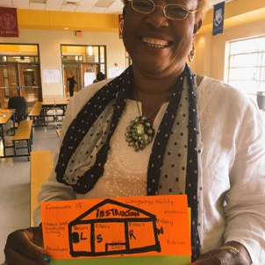
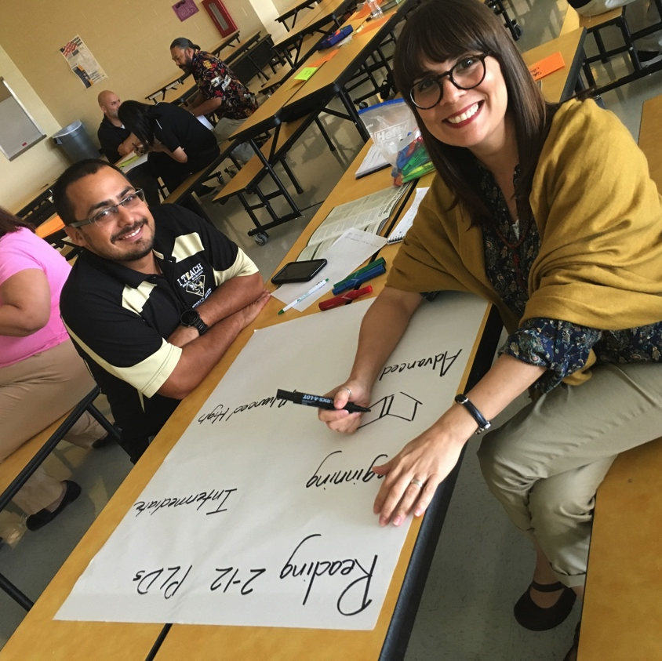
2017-2018 Professional Learning Opportunities
Bilingual/ESL Program
Region One ESC
Karina E. Chapa, M.Ed.
Director
Xóchitl Rocha, Ed.D.
Specialist

Slide 2
LPAC BOY TRAINING
Audience: K-12th LPAC Committees
Identification, placement and assessment decisions can impact ELL achievement. This session will prepare members of your campus/district Language Proficiency Assessment Committee to understand the legal requirements of the LPAC, the required composition of the LPAC and specifically, the beginning of year procedures and documentation requirements for the identification and placement of ELLs. Each district may send up to 5 staff members to the training.
Edinburg Area WS# 65803 September 7, 2017 1-4 PM
Brownsville Area WS# 66004 September 6, 2016 1-4 PM
Laredo Area WS# 65989 September 5, 2016 12-3 PM

Slide 3
LPAC MOY TRAINING
Audience: K-12th LPAC Committees
Assessment decisions have a direct impact in school and district accountability. LPAC members will be trained in how to make the most appropriate assessment decision for each English Language Learner, including the language and version of the test, as well as any necessary and allowable linguistic accommodation. Each district may send up to 5 staff members to the training.
Edinburg Area WS# 65805 December 14, 2017 1-4 PM
Brownsville Area WS# 66134 December 13, 2017 1-4 PM
Laredo Area WS# 65991 December 12, 2017 1-4 PM

Slide 4
LPAC EOY TRAINING
Audience: K-12th LPAC Committees
In order to comply with Chapter 89, subchapter BB of the Commissioner’s Rules, districts must ensure end of the year LPAC procedures are in place. In this session, participants will learn proper end of the year procedures, including annual exit review, reclassification of exited students, progress monitoring, and parent notification. Each district may send up to 5 staff members to the training.
Edinburg Area WS# 65807 April 5, 2018 1-4 PM
Brownsville Area WS# 65993 April 6, 2018 1-4 PM
Laredo Area WS# 65992 April 10, 2018 1-4 PM

Slide 5
SIOP INITIAL TRAINING
Audience: K-12th Teachers and Administrators
SIOP is a comprehensive, coherent, research-validated model of sheltered instruction. In this two-day session participants will develop an understanding of all 8 components and 30 features of the SIOP model: Lesson Preparation, Building Background, Comprehensible Input, Strategies, Interaction, Practice and Application, Lesson Delivery, Review and Assessment. This training is ideal for teachers and administrators serving English Language Learners at all levels of language proficiency. Follow up sessions per components, plus classroom observations are also available.
Available at the district level

Slide 6
THINKING MAPS
Audience: K-12th Teachers and Administrators
Thinking Maps are consistent visual patterns linked directly to eight specific though processes: sequencing, categorization, compare and contrast, describing, analogies, analysis, and cause and effect. In this two-day training, participants will learn how to implement all 8 maps to enhance the conceptual understanding of their ELL students. Follow up sessions by map are also available.
Available at the district level

Slide 7
ExCELL
Expediting Comprehension for English Learners
Audience: 6-12th teachers
ExC-ELL was developed by Dr. Margarita Calderon, Professor Emerita/Research Scientist, Johns Hopkins University. ExC-ELL is a research-based high quality instructional model for content area instruction. Over the course of this four-day training, numerous strategies that stimulate literacy, oral language development, and content comprehension will be modeled and practiced.
Available at the district level

Slide 8
ELPS LIAG TOT
Audience: K-12th Administrator and teachers
The Texas Education Agency promotes teachers use of the ELPS Linguistic Instructional Alignment Guide, which supports the integration of the English Language Proficiency Standards (ELPS) in classrooms k-12. Teachers will explore ways to implement the ELPS into each content area and will learn how to differentiate instruction for each level of language proficiency. Participants will receive 20 ELPS LIAGs to take back to their campus/district to train other educators on its use.
Available at the district level

Slide 9
ELPS Instructional Tool TOT
Audience: PK-12th Administrator and teachers
Session will address second language acquisition and guide participants in the use of the state's ELPS Instructional Tool. Participants will have a better understanding of the why, what, and how of delivering instruction for ELLs and guides schools in providing Title III, Part A supplemental support using the ELPS Instructional Tool. Participants will receive 20 ELPS Instructional tools to take back to their campus/district to train other educators on its use.
Available at the district level

Slide 10
Desarrollando el vocabulario académico
Audience: PK-5th Bilingual teachers
Participants will examine best practices for direct instruction to build students’ academic vocabulary. Spanish terms, and speech and language skills will be explored along with instructional strategies and activities that will help ELLs develop vocabulary in their native language. NOTE: Session will be delivered in Spanish.
Available at the district level

Slide 11
Enseñando la lectura
Audience: K-1st Bilingual teachers
Half of the PK-2 ELL population in Region One speaks Spanish as a native language. Research strongly supports the development of native language as the biggest predictor of future second language acquisition success. This session addresses the essential components of early Spanish reading instruction and includes activities to address transferable skills for English language development. Note: Session will be delivered in Spanish.
Available at the district level

Slide 12
ACELERA
Audience: PK-5th Bilingual teachers
The majority of bilingual students are Spanish-speaking, so it is imperative to learn how to address effective Spanish instruction in PK-5th classroom. This 3-day session is the Spanish version of ExCELL (Expediting Reading Comprehension for ELLs), developed by Dr. Margarita Calderón. Participants will focus on the development of academic language and the integration of reading, writing, listening, speaking and grammar through the use of various strategies that model and stimulate literacy, oracy, and content mastery.
Available at the district level

Slide 13
Gramática y ortografía en español
Audience: PK-5th Bilingual teachers
One of the biggest challenges for bilingual teachers of Spanish speaking students is the use of formal academic Spanish vocabulary in the classroom. In this 2-day session, teachers will practice the use of the traditional Spanish spelling and writing skills, while developing resources to teach through their student’s native language. Teachers will receive materials, master copies to develop manipulatives, and the book: La ortografía de la lengua Española, reglas y ejercicios, published by Larousse.
Available at the district level

Slide 14
Capacitando a los padres de estudiantes bilingües
Audience: Parents of English Language Learners
In order for ELLs to be successful in school and in life, school systems must honor and empower their families and their communities. In this one-day session, parents will learn about the following topics: the characteristics of English Language Learners; how schools identify and place bilingual children; and the laws governing bilingual/ESL education in Texas. This session supports Title III funded districts in meeting requirements for parent and community participation. Participants will receive resources and strategies to better support the academic development of their children at home. Note: Session will be delivered in Spanish.
Available at the district level

Slide 15
BTLPT
Audience: Teachers seeking a bilingual certification
Educators will review important information to obtain the best scores possible and obtain their Bilingual certification. They will learn the best test-taking strategies and obtain additional home-study materials. This session will address the test framework, and teachers will have the opportunity to practice reading, listening and writing skills in Spanish.
Available at the district level

Slide 16
ESL TExES
Audience: Teachers seeking an ESL certification
This session is designed to help Texas educators prepare for the ESL TExES test #154. Teachers will gain valuable knowledge based on the Texas educator standards. They will review the ESL TExES domains, competencies, and the test questions format, information on state mandated ESL policies, second language acquisition, language concepts, ESL instructional strategies, and English literacy development.
Available at the district level

Slide 17
ELL Leadership Academy
Audience: Campus and District Instructional Leaders
Instructional leaders must develop a deep understanding of ELL issues in order to ensure the academic, linguistic and affective success of this growing population. During this 6-day academy, leaders will explore and analyze a variety of topics, including: second language acquisition; LPAC decision-making and its impact on instruction; ELL data analysis, coding and state/federal accountability; best instructional practices for ELLs; among others. Cohort will meet face-to-face six times a year and participate in a virtual community through Edmodo.
WS# 66156 $750 per person for all 6 days and access to virtual community
09/26, 11/14, 12/19, 2/6, 4/3, 5/24

Slide 18
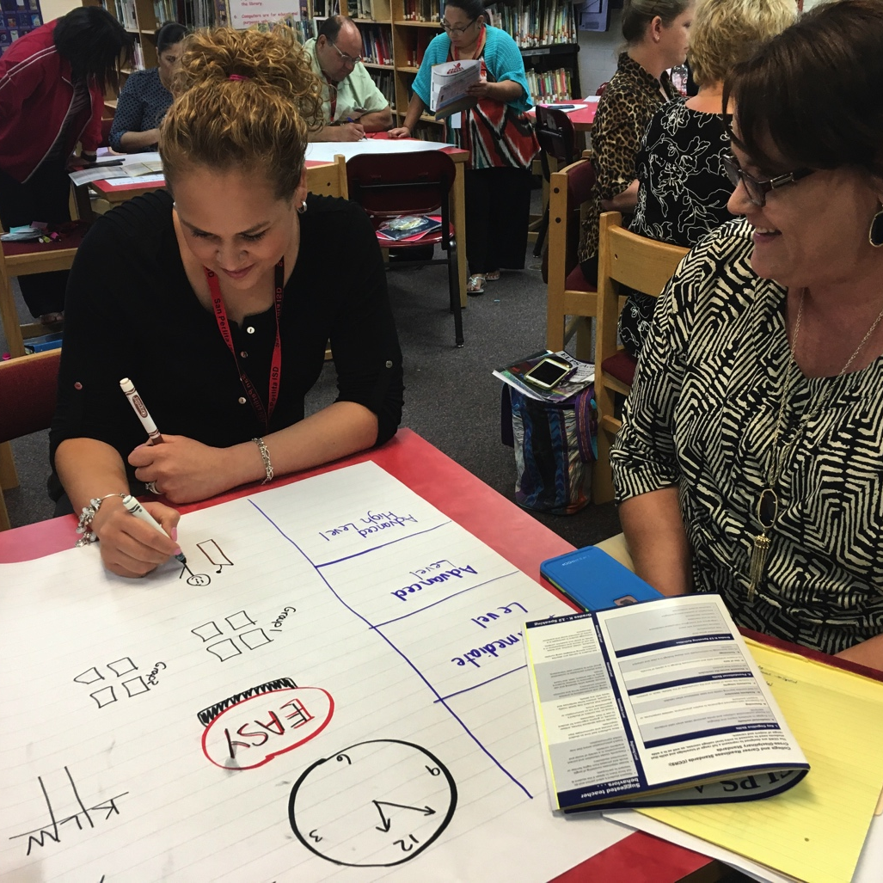
Get Connected!
Karina E. Chapa, M.Ed.
Director
kchapa@esc1.net
Xóchitl Rocha, Ed.D.
Specialist
xrocha@esc1.net
Facebook
Region One ESC Bilingual
Twitter
@esc1bilingual

